Slide 1








Unit 5.1
Software Engineering
Software
Testing

Slide 2

Verification & Validation
Verification
Are we building the product right?
The objective of Verification is to make sure that the product being develop is
as per the requirements and design specifications.
Validation
Are we building the right product?
The objective of Validation is to make sure that the product actually meet up the user’s requirements, and check whether the specifications were correct in the first place.

Slide 3
Verification vs Validation
Verification
Validation
Process
of
evaluating
products
of
a
Process of evaluating software at the end
of the development to determine whether software meets the customer expectations and requirements.
development phase to find out whether
they meet the specified requirements.
Activities involved: Reviews, Meetings and
Activities involved: Testing like black box testing, white box testing, gray box testing
Inspections
Carried out by QA team
Carried out by testing team
Execution of code is not comes under
Verification
Execution of code is comes under
Validation
Explains whether the outputs are according to inputs or not
Describes whether the software is
accepted by the user or not
Cost of errors caught is less
Cost of errors caught is high

Slide 4




Software Testing
Testing is
intent
the process of exercising a program with the specific
of
finding
errors
prior
to
delivery
to
the
end
user.
Don’t view testing as a “safety net” that will catch
all errors that
occurred because of weak software engineering practice.

Slide 5
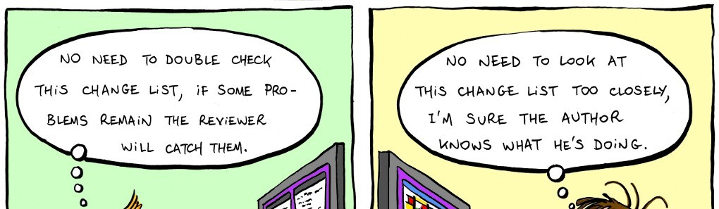

Software Testing

Slide 6


Who
Test
the
Software
Developer
Tester
Understands the system
test "gently"
but, will
Must
but,
learn about the system,
will attempt to break it
and, is driven by "delivery"
and, is driven by quality
Testing need a strategy
Dev team needs to work with Test team, “Egoless Programming”
Testing without plan is of no point
It wastes time and effort

Slide 7
Software Testing Strategies
• A strategy for software testing integrates the design of software test cases into a well-planned series of steps that result in successful development of the software
• The strategy provides a road map that describes the steps to be taken, when, and how much effort, time, and resources will be required
• The strategy incorporates test planning, test case design, test execution, and test result collection and evaluation
• Because of time pressures, progress must be measurable and problems must surface as early as possible

Slide 8
Characteristics of Strategic Testing
• To perform effective testing, a software team should conduct effective formal technical reviews
• Testing begins at the component level and work outward toward the integration of the entire computer-based system
• Different testing techniques are appropriate at different points in time
• Testing is conducted by the developer of the software and by an independent test group
• Testing and debugging are different activities, but debugging must be accommodated in any testing strategy

Slide 9
Software Testing Strategy
System Testing
Validation Testing
Integration Testing
Unit Testing
Code
Design
Requirements
System Engineering

Slide 10


Software
Testing Strategy Cont.
Unit Testing
•
It concentrate on each unit of the software
as implemented in source code.
•
It
focuses
on
each
component
individual,
ensuring that it functions properly as a unit.
Integration Testing
•
It
focus
is
on
design
and
construction
of
software architecture
Integration testing is the process of testing the interface between two software units or modules
•

Slide 11

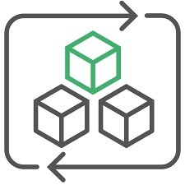
Software
Testing Strategy Cont.
Validation Testing
•
Software
is
validated
against requirements
established as a part of requirement modeling
•
It
give
assurance
that
software
meets
all
and
informational,
functional,
behavioral
performance requirements
System Testing
•
The software and other
tested as a whole
Software once validated,
software elements
are
•
must be combined with
other
system
elements
e.g.
hardware, people,
database etc…
It verifies that all elements mesh properly and that overall system function / performance is achieved.
•

Slide 12
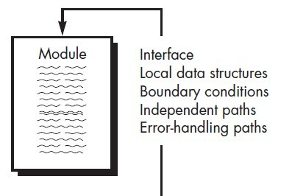
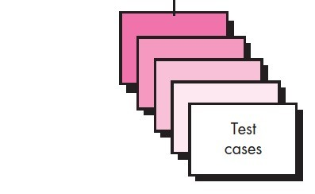
Unit
Testing
▪
Unit
is the
smallest part
of
a
software system which is testable.
▪
Unit Testing validates small building
block
of
a
complex
system
before
testing an integrated large module or
whole system
The unit test focuses on the internal processing logic and data structures
▪
within
the
boundaries
of
a
component.

Slide 13
Unit Testing Cont.
▪
The module is tested to ensure that information properly flows
into and out of the program unit
Local data structures are examined to ensure that data stored temporarily maintains its integrity during execution
▪
▪
All
independent
paths through
the
control
structures
are
exercised to ensure that all statements in module have been
executed at least once
▪
Boundary
conditions
are
tested
to
ensure
that the
module
operates properly at boundaries established to limit or restricted
processing
All error handling paths are tested
▪

Slide 14
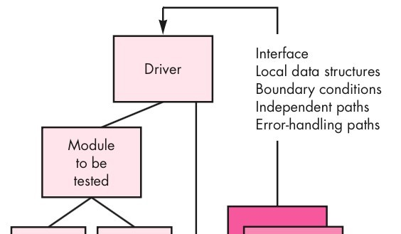
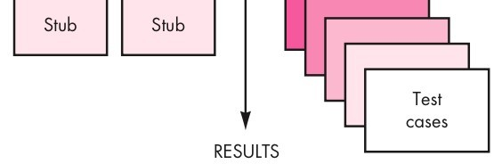
Unit
Testing
Cont.
▪
Component-testing (Unit Testing)
may
be
done
in
isolation
from
rest of the system
In such case the missing software
is replaced by Stubs and Drivers
▪
and
simulate
the
interface
software manner
between
the
components in a simple

Slide 15
Unit
Testing Cont.
▪
Let’s take an example to understand it in a better
way.
Suppose there is an application consisting of three modules say, module A, module B & module C.
Developer has design in such a way that module B
A
▪
▪
depends on module A & module
module B
C depends on
B
▪
The developer has developed the
now wanted to test it.
But the module A and module C
developed yet.
module B and
▪
has not been
C
▪
In that case to test the module B completely we
can replace the module A by Driver and module C
by stub

Slide 16
Unit Testing Cont.
▪
▪
Driver and/or Stub software must be developed
for
each
unit
test
A
•
•
•
driver is nothing more than a "main program"
It accepts test case data
Passes such data to the component and
Prints relevant results.
▪
Driver
•
•
•
•
Used in Bottom up approach
Lowest modules are tested first.
Simulates the higher level of components
Dummy program for Higher level component

Slide 17
Unit Testing Cont.
▪
Stubs serve to replace modules that are subordinate
the component to be tested.
(called
by)
▪
A
•
•
•
•
stub or "dummy subprogram"
Uses the subordinate module's interface
May do minimal data manipulation
Prints verification of entry and
Returns control to the module undergoing
testing
▪
Stubs
•
•
•
•
Used in Top down approach
Top most module is tested first
Simulates the lower level of components
Dummy program of lower level components

